Slide 1
Artificial Intelligence
4: Informed Search
Alvin Tjondrowiguno & Andre Gunawan

Slide 2
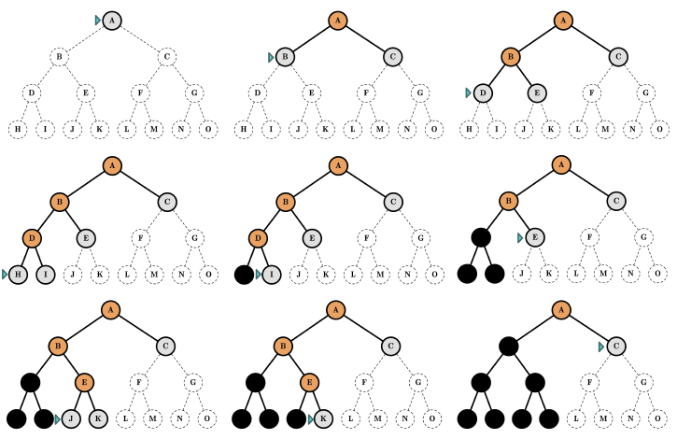
Previously: Uninformed Search

Slide 3
Informed Search
A search strategy that uses domain knowledge (about the goal)
Problem-specific knowledge beyond the definition of the problem
Uses a heuristic function to estimate how close a state is to the goal
Also called “heuristic search”
The general approach is called best-first search
Essentially still exploring the search tree by expanding nodes in a certain order
Best-first search selects nodes to expand based on an evaluation function f(n)

Slide 4
Heuristic
A problem-solving approach that is …
Practical
Not guaranteed to be optimal
Sufficiently satisfactory
Used when finding an optimal solution is considered infeasible
Using some kind of rule of thumb
Supposed to work in most, but not all, situations

Slide 5
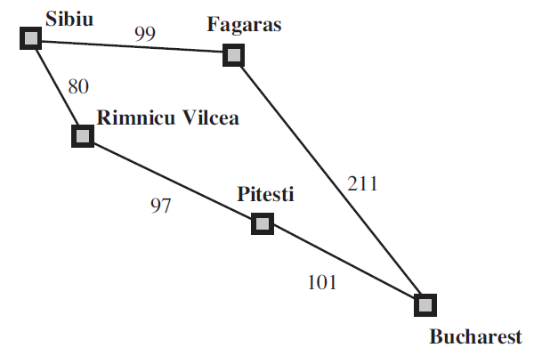
Uniform-Cost Search
Uniform-cost search selects nodes to expand based on the total path-cost from the initial state
The nodes with the lowest total path-cost are expanded first
Let g(n) be the total path-cost from the initial state to the state n in the search tree
Best-first search is implemented the same way as uniform-cost search
Best-first search uses f(n)
Uniform-cost search uses g(n)

Slide 6
Informed Search
The choice of the evaluation function f(n) determines the search strategy
Most best-first algorithms include a heuristic function h(n) as a component of f
h(n) is the estimated cost of the cheapest path from the state at node n to a goal state
This heuristic function is the most common form of additional domain knowledge used in the search algorithm
h(n) is arbitrary and problem-specific

Slide 7
Informed Search
Informed search strategies:
Greedy Search / Greedy Best-First Search
A*

Slide 8
Greedy Best-First Search

Slide 9
“Greedy” Algorithms
A problem-solving heuristic where locally optimal decisions are chosen
Locally optimal means that each chosen decision is optimal with respect to each particular “current” situations
Greedy heuristics do not take into account future ramifications of each decision
Greedy heuristics are usually not optimal in the long run, but very practical

Slide 10
Greedy Best-First Search
Greedy best-first search expands nodes that appears to be closest to the goal
It is assumed that this would lead to the goal quickly
The evaluation function f(n) contains only the heuristic component h(n)
h(n) is the estimated cost of the cheapest path from the state at node n to a goal state

Slide 11
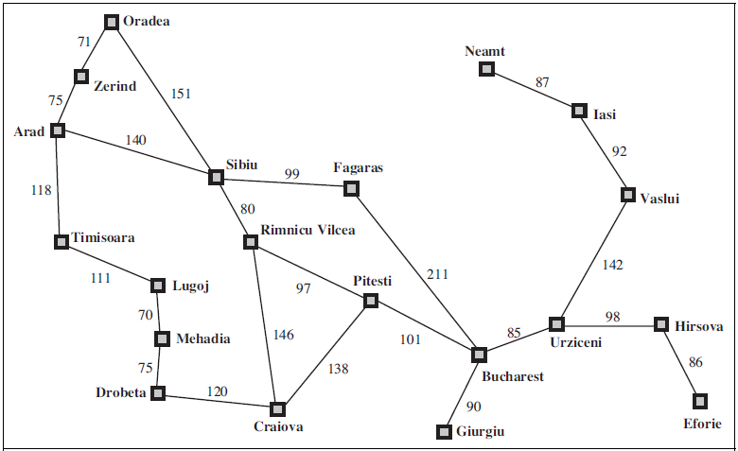
Example: Path-Finding Problem
Start
Destination

Slide 12
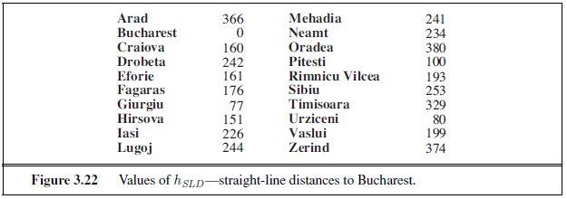
Greedy Best-First Search: Heuristic
To use greedy best-first search on the pathfinding problem, first we need to define a heuristic to estimate the cost of the cheapest path from each state to the goal
A very common heuristic to use is the straight-line distance heuristic
h_{SLD}(n) = The straight-line distance from a city n to the destination city

Slide 13
Path-Finding Problem: Solution
Arad
366
Sibiu
253
Sibiu
253
Lowest!
Fagaras
176
Arad
366
Timisoara
329
Bucharest
0
Lowest!
Oradea
380
SLD to goal (Bucharest)
Lowest!
Goal reached!
Zerind
374
Rimnicu Vilcea
193

Slide 14
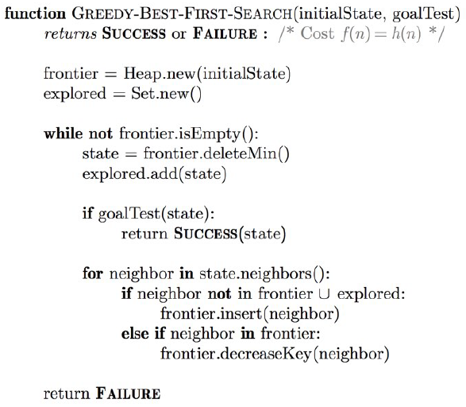
Greedy Best-First Search: Pseudocode

Slide 15
Greedy Best-First Search: Analysis
Evaluation of the search strategy:
Completeness: No (on infinite-depth state spaces)
Optimality: No
Time Complexity: Exponential (in the worst case)
Space Complexity: Exponential (in the worst case)

Slide 16
A* (A-Star) Search

Slide 17
A* Search
A* search is the most widely known form of best-first search
A* expands nodes based on an evaluation function f(n) which is a combination of:
g(n) = The cost to reach state n from the initial state
h(n) = The estimated cost to reach a goal state from state n
f(n) = g(n) + h(n)
f(n) is the estimated cost of the cheapest solution through state n
The implementation is also identical to uniform-cost search and greedy best-first search, only the cost function used is different

Slide 18
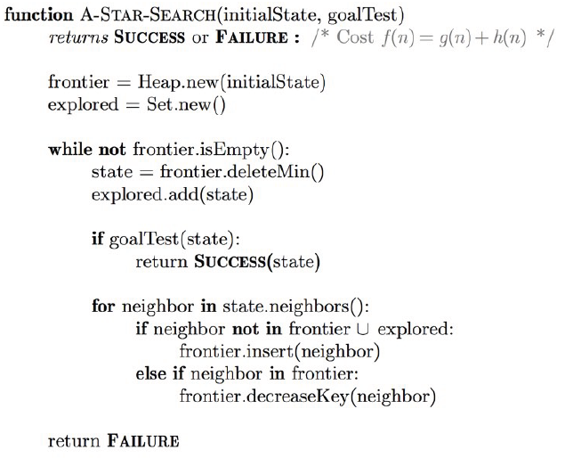
A* Search: Algorithm

Slide 19
A* Search: Heuristics
The completeness and optimality of A* search depends on the quality of the heuristic function
A* search is complete and optimal IF the heuristic function is:
Admissible: The heuristic function never overestimates the cost to reach the goal The estimation is always cheaper than the actual cost to reach the goal h(n) ≤ h*(n) where h*(n) is the actual cost of reaching the goal from state n
Monotonic: The estimated cost of a direct path is always cheaper than the estimated cost of a different path passing through another state h(n) ≤ c(n, a, n’) + h(n’) where c(n, a, n’) is the path-cost of going from state n to n’ using action a

Slide 20
A* Search: Heuristics
Every monotonic heuristic is admissible
Monotonicity is the slightly stronger condition
However, it is actually difficult to find a heuristic that is admissible but not monotonic
h_{SLD} (straight line distance) is an admissible and monotonic heuristic, therefore it is very commonly used

Slide 21
A* Search: Analysis
Evaluation of the search strategy:
Completeness: Yes (as long as h(n) is admissible and monotonic)
Optimality: Yes (as long as h(n) is admissible and monotonic)
Time Complexity: Exponential (in the worst case)
Space Complexity: Exponential (in the worst case)
In practice, A* usually runs out of space long before it runs out of time

Slide 22
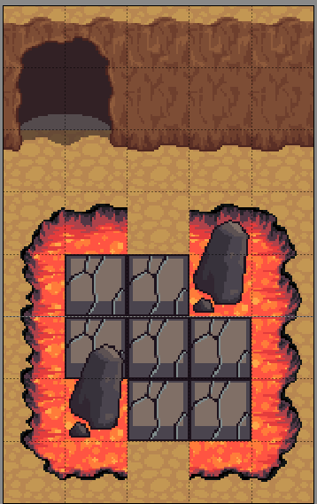
Goal: Go to Exit with all Cracked Path explored.
Action: Up, Down, Left, Right
Condition:
When Cracked Path explored, that tile become Magma and cannot be explore again!

Slide 23

Goal:
Go to the Treasure Chest with Shortest Path!
Action: Up, Down, Left, Right
Condition:
Cannot go into tile with rock.
You can cut the tree with blade!
Your blade can only cut 2 Trees

Slide 24
Thank you for listening

